Slide 1

UMBC Cyber Defense Team Defensive Technologies
Bryan Vanek
2016-2017

Slide 2

What will we be covering in this presentation?
Defensive Technologies Overview
SELinux: what it is and why it’s important
Context, Policy, and Booleans
Nagios: infrastructure monitoring
Touch on PFSense if we have time
Lab focusing on configuration of Nagios

Slide 3
So far this semester, we’ve focused on offense…
…but now we come to ways that we can mitigate that.
Antivirus means basically nothing in today’s world of security.
Need for other utilities to help with monitoring these items
Different kinds of firewalls, policy, infrastructure monitoring, IDS/IPS, etc.
Today, our main focus will be policies and infrastructure monitoring
***Useful stuff for CCDC in here, for those that are interested!!**

Slide 4

SELinux: What the heck is it?
Security-Enhanced Linux
Known as a Mandatory Access Control (or just MAC) security mechanism
Think of it like an employee at a company: the COMPANY decides how the data provided by the employee is shared.
Whoever sees it is limited by the company-we don’t want everyone to see it!
Can be more formally defined as a policy defined by an administrator, strictly enforced by the OS, and unable to be edited by end users.
SELinux is built into the Linux kernel as a security module
Was originally developed by the NSA, and then handed off to the open-source community in 2008.

Slide 5

By default, SELinux already comes installed!
You always need to be a root user when doing any kinds of modifications
Useful utilities to have installed for management:
policycoreutils (contains restorecon)
policycoreutils-python (contains semanage)
setroubleshoot (for when SELinux becomes hard to manage)
Oh yeah, and SELinux WILL be a pain in the butt to manage sometimes. Like what happened to Zack last Saturday!

Slide 6
So, let’s talk about policy
A policy is all of the settings in terms of what can do what on a system.
In SELinux’s case, these include booleans and labels
These attributes are then applied to every file, process, directory, and port.
Not just limited to file access and programs!
Three basic policies built in to SELinux
Targeted, minimum (bad), mls (more advanced)
By default, ALWAYS run targeted, unless you’re developing.
Can view policy and enforcement details by running sestatus

Slide 7
Modes and Labels
SELinux has three different ‘modes’
Enforcing, permissive (BAD), disabled (EVEN WORSE)
Can view and enable these with getenforce and setenforce
**Can’t turn disable on like this-that would require kernel modification**
Note: if you ever want to see how these are defined, you can look at the selinux config file at /etc/selinux/config
SELinux also has four different ‘labels’ for flexible management
User, Role, Type, Level/Sensitivity (TYPE IS THE IMPORTANT ONE)
Can view this information by doing ls –Z (for context) or ps –Z (for processes)
You can also set these labels through the use of semanage, chcon and restorecon
Transition to brief demo!

Slide 8
Booleans are also a thing!
These are on/off switches for SELinux.
Can view these (and their current state) with getsebool –a (or view individual booleans) or semanage boolean –l for more detail
Grep will be your friend in looking at this stuff
APPLICATION PROBLEMS ARISE HERE
You can set these booleans with setsebool <Boolean name> on/off
Adding the P flag makes these changes persistent.
Last little note: you can view available selinux policies in your system/repo with the following commands:
Yum list installed | grep selinux
Yum search selinux-policy

Slide 9

It should also be noted…
SELinux isn’t infalliable-it’s just another utility that helps
In fact, because of how close it is to the kernel, some people have used it as an attack vector.
2015 CVE: remote code execution through setroubleshoot: http://www.cvedetails.com/cve/CVE-2015-1815/
This drives home the fact that there is no one solution to anything-YOU NEED TO TAKE RESPONSIBILITY FOR THAT.

Slide 10

Moving on, let’s talk about Nagios…
Firewalls and policies are great, but it would be nice if we could monitor all of our devices in one area!
Nagios can help us do this-it can monitor…
Servers, routers, switches
Services
Specific Protocols
Individual applications
It can also help with finding and diagnosing problems before they occur!

Slide 11
Some requirements for use…
Some kind of HTTPD server (LAMP stacks should be proficient in terms of our purposes)
IPTables is usually a good thing to have knowledge of
List of dependencies:
gd, gd-devel, gcc, glibc, glibc-common
nrpe, Nagios-plugins-all, openssl
SSL tunneling/SSH allows us to perform remote monitoring!

Slide 12
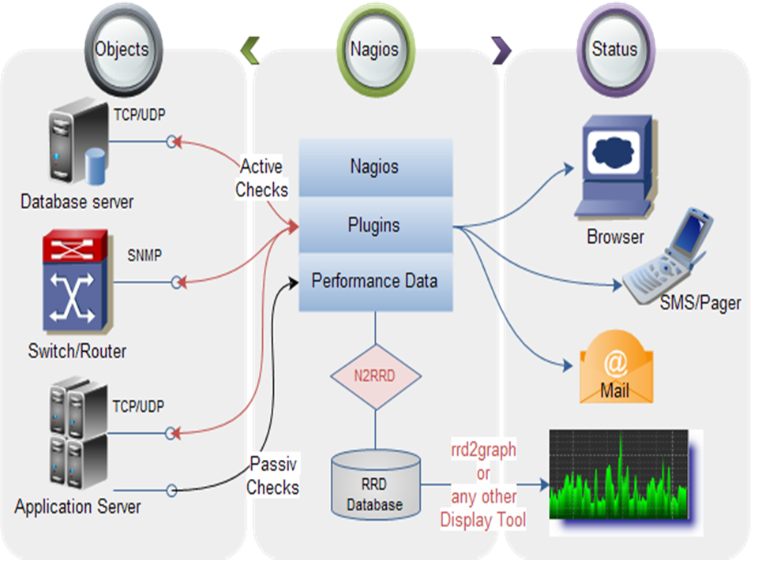

Slide 13
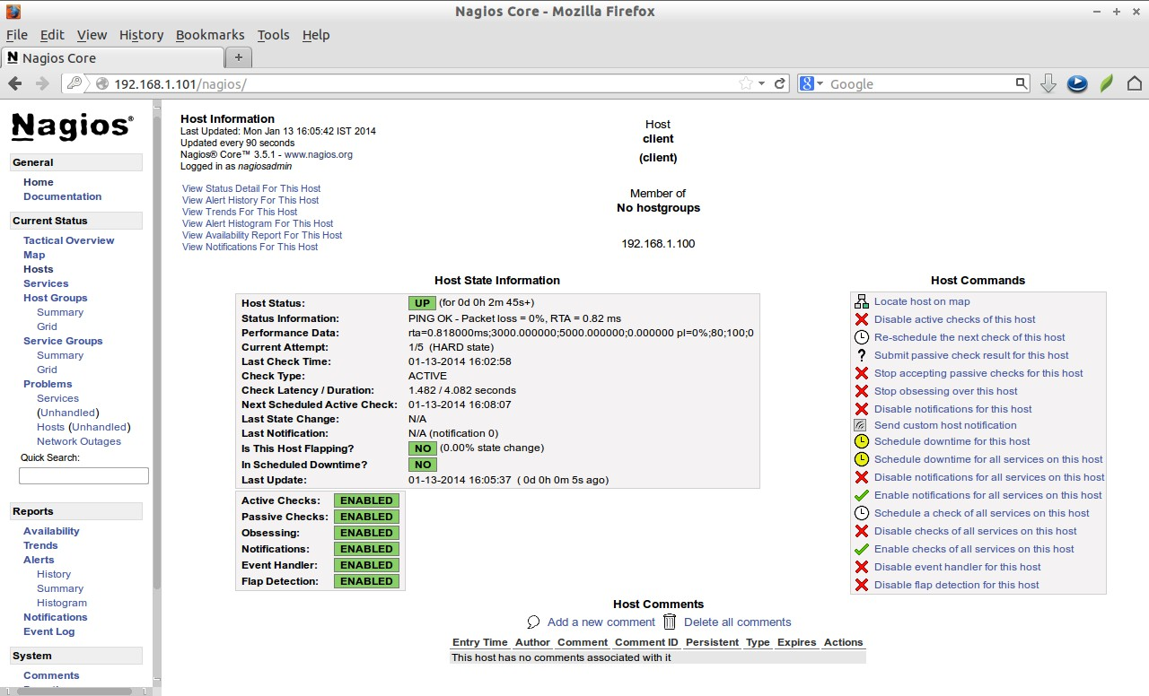

Slide 14
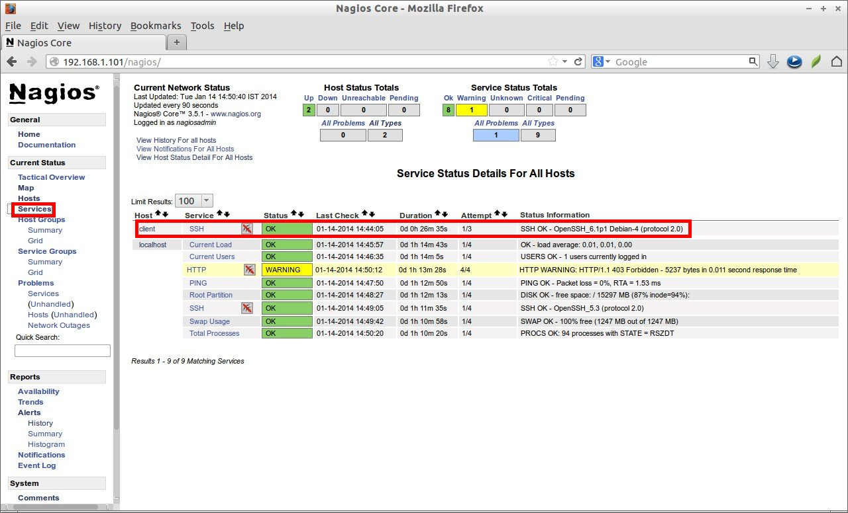

Slide 15
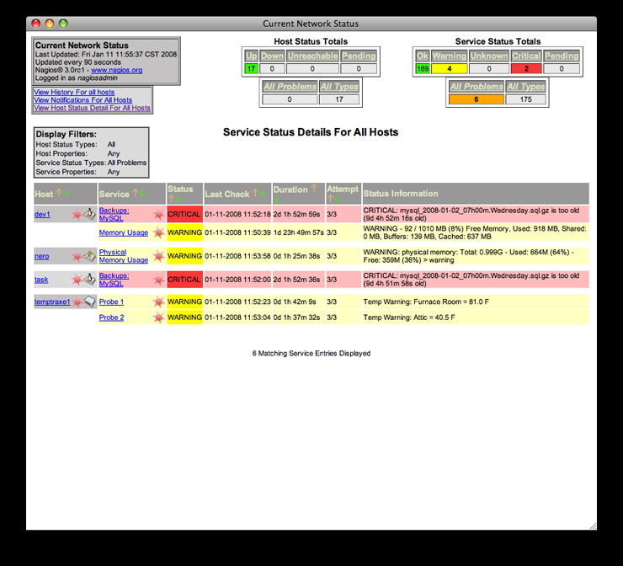

Slide 16

A really cool tool…
…but can be tough to set up!
This will be a component of our lab today
Not just the installation and configuration, but also getting it to work with SELinux appropriately
There are a couple booleans that you’ll need to enable
There are also a couple policies that you’ll need to change

Slide 17

Finally, I want to mention something…
PFSense: An open source firewall-specifically, a network firewall
Different from IPTables in a couple senses:
It performs true stateful inspection (checks not just the packet itself, but whether or not the packet is EXPECTED to be like that based on the connection)
It has one configuration file that takes in your packets
Provides Dynamic Modification (modifying tables, lists, anchors on the fly)
VERY fast
This is used primarily as a perimeter firewall-usually installed on its own system or own vm.
Can also serve as an AP, DHCP Server, DNS Server, and even a VPN endpoint!
Also comes with a bunch of super useful plugins and capabilities
Can work with IDS/IPS (Snort, Bro, etc.)
PFBlocker: international IP download management (SUPER USEFUL)
We will be covering this as it’s own thing next semester!

Slide 18
So, here’s what we’re doing today…
In your CentOS VMs, install…
Openfire
HTTPD
Nagios
Setup proxies for both Openfire and Nagios
http://localhost/openfire
http://localhost/nagios
Use IPTables to block direct access to Openfire and Nagios
Keep SELinux enabled while you do all of this
Add the OpenFire service to Nagios + monitor it’s appropriate ports
IF YOU FINISH THIS STUFF, PRACTICE MORE WITH SELINUX
Try to configure HTTPD to run on port 8001
If you’re feeling super saucy, install a CGI backdoor and see what happens when you try to access a system with/without SELinux (BACKUP/SNAPSHOT YOUR VM BEFORE DOING THIS)

